Slide 1
Workflow Management with Activiti BPM,BPMN-JS

Slide 2
Agenda
Overview of BPM
Overview of Activiti BPM
BPMN JS
Demo

Slide 3
What is Business Process and Business Process Management
Business Process:
A business process is an activity or set of activities that will accomplish a specific organizational goal.
Business process management (BPM) is a systematic approach to improving those processes.
Business Process Management:
Business process management (BPM) is a systematic approach to making an organization's workflow more effective, more efficient and more capable of adapting to an ever-changing environment.

Slide 4
Activiti BPM
Activiti is a light-weight workflow and Business Process Management (BPM) Platform targeted at business people, developers and system admins.
Its core is a super-fast and rock-solid BPMN 2 process engine for Java. It's open-source and distributed under the Apache license.
Activiti runs in any Java application, on a server, on a cluster or in the cloud.

Slide 5
BPMN-JS
BPMN-JS is a BPMN 2.0 rendering toolkit and web modeler. It is written in JavaScript, embeds BPMN 2.0 diagrams into modern browsers and requires no server backend. That makes it easy to embed it into any web application.
The library is built in a way that it can be both a viewer and web modeler. Use the viewer to embed BPMN 2.0 into your applications and enrich it with your data. Use the modeler to create BPMN 2.0 diagrams inside your application.

Slide 6
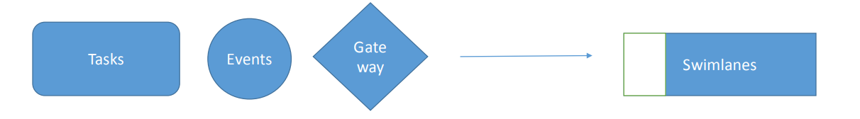
BPMN Elements
BPMN(Business Process Modelling Notation):
BPMN is a method of illustrating business processes in the form of a diagram similar to a flowchart.
Tasks: represented as rectangular shape.
Events: represented as circular shape.
Gateways: represented as diamond shape.
Connecting objects: represented as arrow shape.
Swimlanes: represented as path shape. Tasks Events Gate way Swimlanes

Slide 7
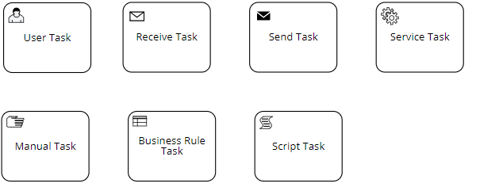
Types of Tasks

Slide 8
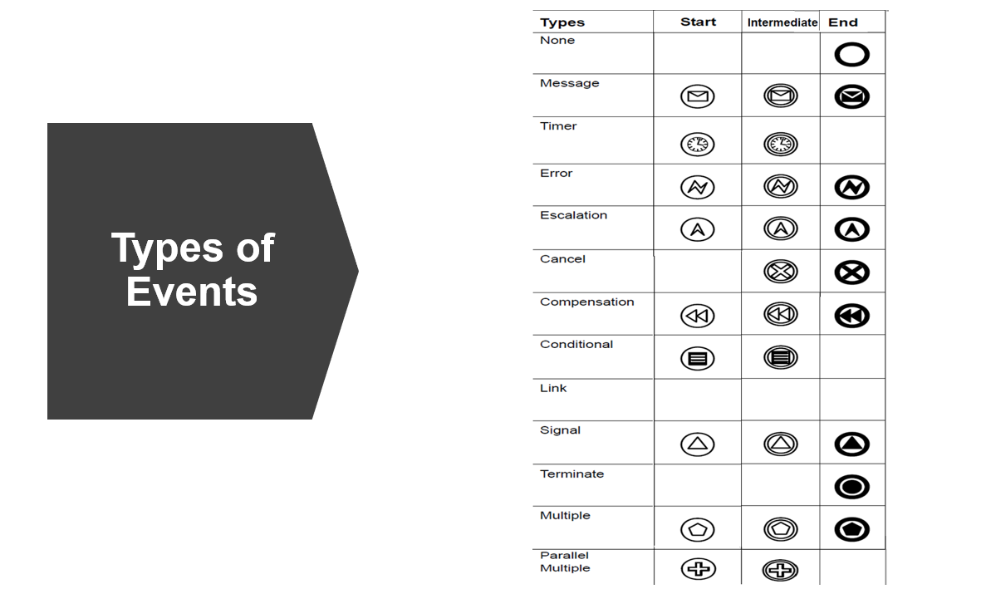
Types of Events

Slide 9
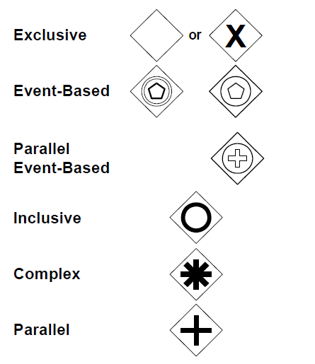
Types of Gateways

Slide 10
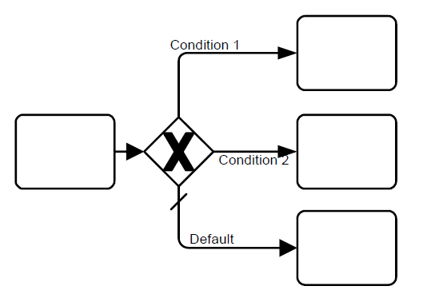
Types of Gateways
Exclusive Gateway

Slide 11
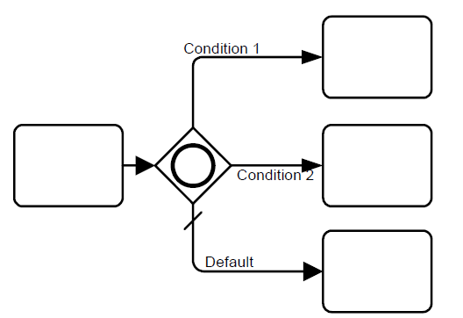
Types of Gateways
Inclusive Gateway

Slide 12
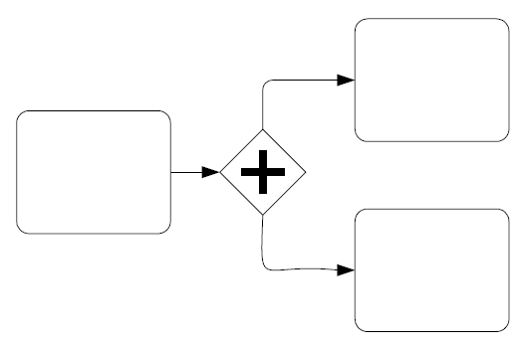
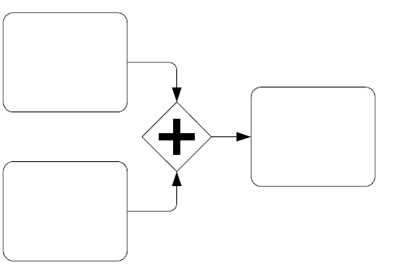
Types of Gateways
Parallel Gateway

Slide 13
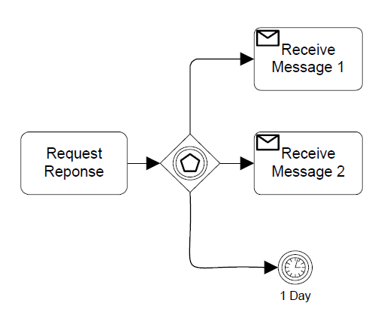
Types of Gateways
Event-Based Gateway

Slide 14
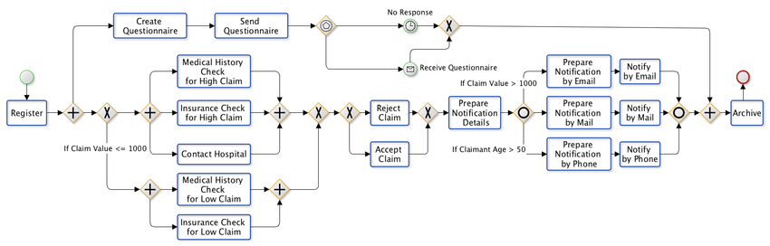
Business Process Diagram

Slide 15
THANK YOU

